Slide 1
Preliminary L3 Safety Concept
Detail need further safety analysis. Draft only for discussion
ESS3

Slide 2
Detail need further safety analysis. Draft only for discussion
Agenda Overview
L3 system scope assumption
L3 safety concept

Slide 3
L3 system scope assumption(refer to ECE R157e)
Detail need further safety analysis. Draft only for discussion
Preliminary L3 safety concept
L3 Feature and Architecture Alignment
Driver eye-off、Driver monitor、10s hand-over to driver
Speed(0-60 kph)
Environment condition
Road profile (curvature, elevation)
No pedestrian
physical separation
night and day
Lane keeping、Vehicle following、Target vehicle cut-in
Safe stop in lane(MRM)
More scenario extended, more challenge to system performance → more FuSa & SOTIF challenge

Slide 4
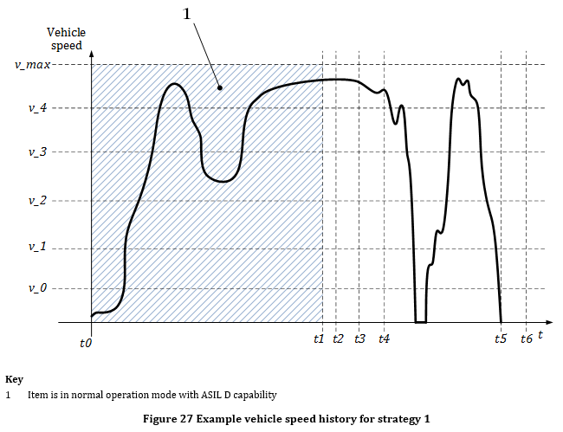
Proposal Emergency Operation & Safe State
Detail need further safety analysis. Draft only for discussion
Preliminary L3 safety concept
Fault
Fail operational
Replace with
¹ A given element can be fail passive for one functionality and fail active for another
Fail active (functionality)¹
FTTI
Distinguish between
T_{eotti}
Fail degraded (functionality)¹
Fail operational (functionality)¹
Provide functionality with reduced performance
Provide functionality with nominal performance
Safe State:
Functionality
deactivated
Proposal
(cost saving)
Safe States
Option 1: Deactivate until repair/ MRM finished
Option 2: Provide functionality without time restrictions within restricted vehicle operating states (ASIL capability ≥ ASIL (hazard))
*Source: ISO 26262-10:2018

Slide 5
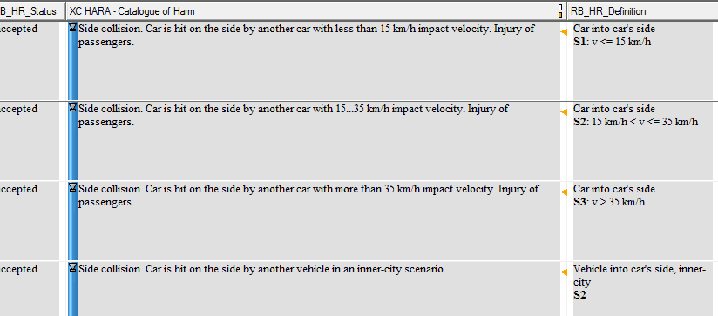
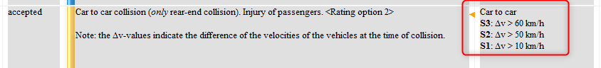
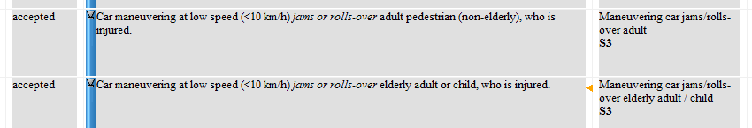
Preliminary top level safety concept
Detail need further safety analysis. Draft only for discussion
Preliminary L3 safety concept
Max_Vspeed 60kph
Urban/Expressway/Highway- ASIL C(S2 C3 E4) to car
ASIL D(S3 C3 E4) to pedestrian
Urban/Expressway- ASIL D(S3 C3 E4)
Highway- ASIL B(S1 C3 E4)
Fail-degraded related
Max_Vspeed 60kph
Keep ODD within 60kph- ASIL D(S3 C3 E4)
UI loss of deceleration → ASIL D
UI loss of lateral control
→ Highway(ASIL B), urban/expressway(ASIL D)

Slide 6
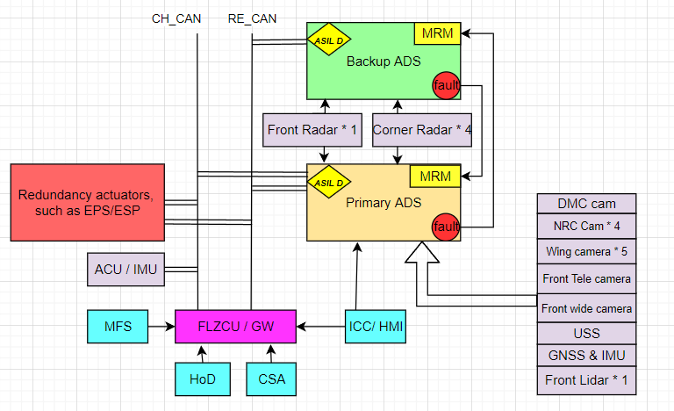
Preliminary safety concept allocation
Detail need further safety analysis. Draft only for discussion
Preliminary L3 safety concept

Slide 7
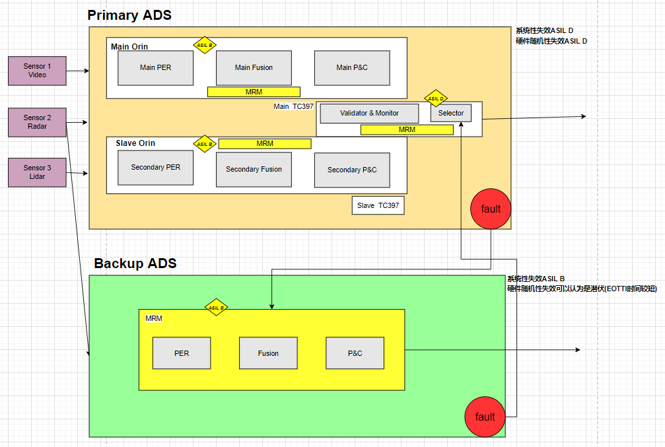
Preliminary safety concept allocation
Detail need further safety analysis. Draft only for discussion
Preliminary L3 safety concept

Slide 8
Preliminary POC safety minimum requirements
Detail need further safety analysis. Draft only for discussion
Preliminary L3 safety concept
 | WP no breakdown yet | POC minimum scope | Comments
1 | Top down safety concept derivation incl. concept level and system level incl. global core team review | Part | Potential risk: No maturity safety concept and safety development experience; No maturity SOTIF development experience; Compliance risk and release SW to COEM w/o safety implementation; Others?
2 | (ASIL xx) HW+ safety development(DFA/SSA/FFI/FMEDA/safety arch etc.) incl. global core team review | Part
3 | (ASIL xx) ASW safety development (DFA/SSA/FFI/FMEDA/safety arch etc.) | Part
4 | (ASIL xx) V&V | Part
5 | (ASIL xx) supporting process | Part
6 | (ASIL xx) safety management | Part
7 | SOTIF(management/supporting/engineer, analysis,concept,strategy,area2/3 test etc.) | Part
8 | ICV regulation support such as documentation, simulation, test(FIU) etc. | All

